Slide 1
Midterm Website
Hung Truong

Slide 2
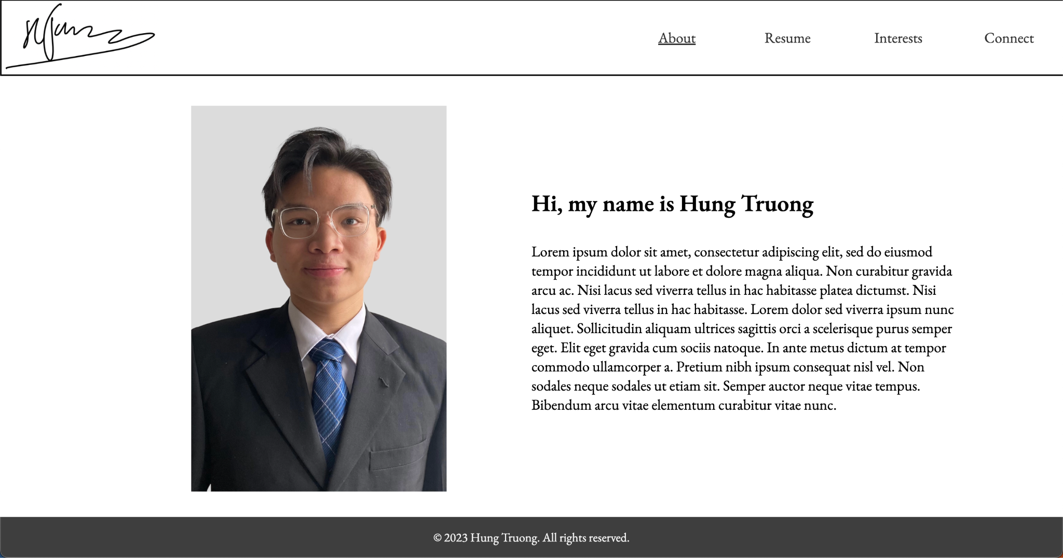
Main Page
Professional, sleek theme
All 1-page so limited need to scroll
Want-to do:
Signature animation upon load

Slide 3
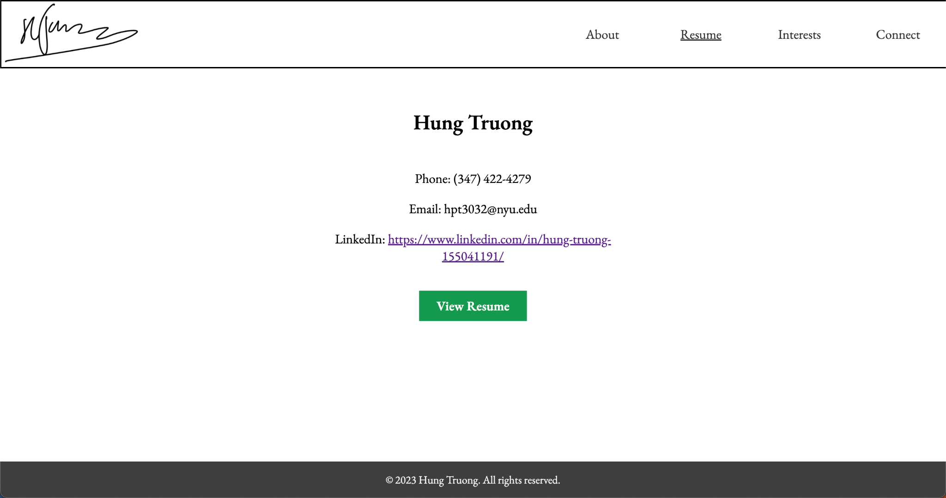
Resume Page
Very brief and clean
Link to PDF file of resume

Slide 4
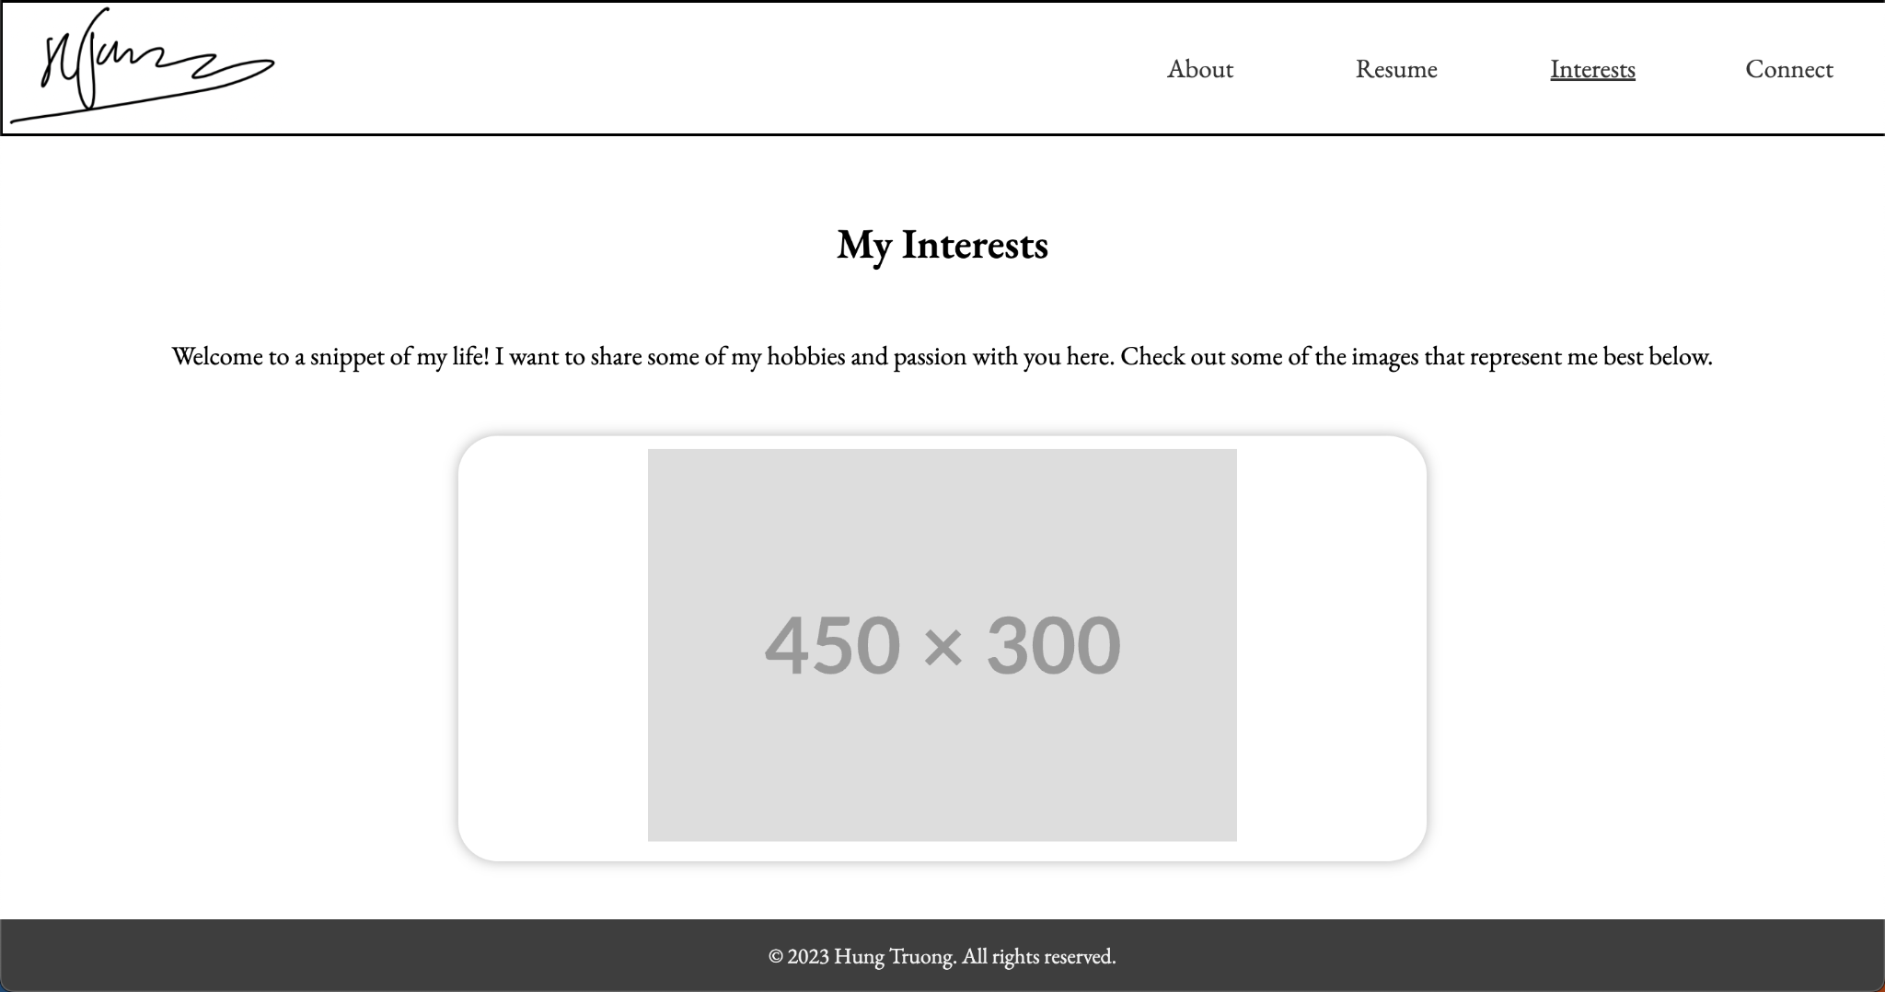
Interests Page
Temporary placeholder image
Eventually turned into a slideshow
Currently, I have animation that enlarges the slideshow on hover

Slide 5
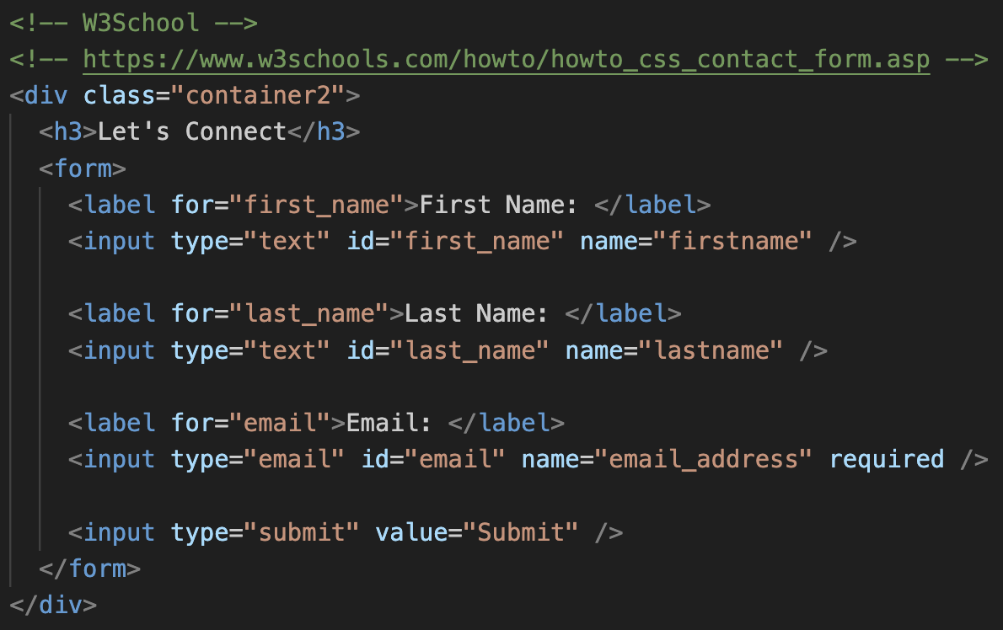
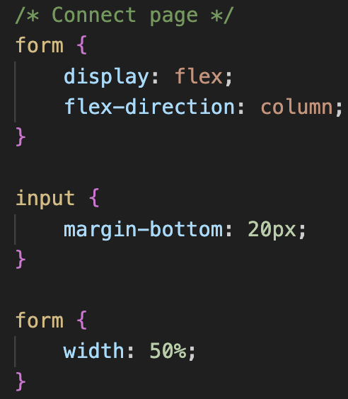
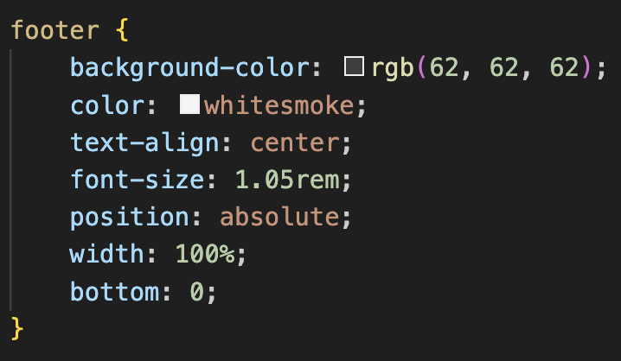
Snippet of code
Contact form
I had learnt the code from W3Schools
It also took me a while to format the CSS for this but I think it turned out great. The box shadow adds a different side to the clean asthetic
CSS
Media query

Slide 6
Next Steps
Summary:
Signature animation upon loading into the website (Javascript possibly)
Interactive image slideshow with arrows on both sides to click on to next images
I may combine the resume and interests page into the home page
If so, I would like to do a dynamic “click-to-top” button that follows mouse-y location

Slide 7
THANK YOU!
Hung Truong

